Slide 2
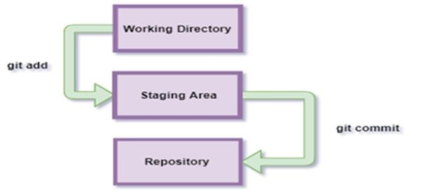
Stages
First Commit
Staging Files
Committing Files
add --a
Git commit –m “message”

Slide 3
GETTING A GIT REPOSITORY
Home for all files and projects
Defining Repository
Creating a New Repository
Cloning an Existing Repository
Process of Creation of Repositories

Slide 4
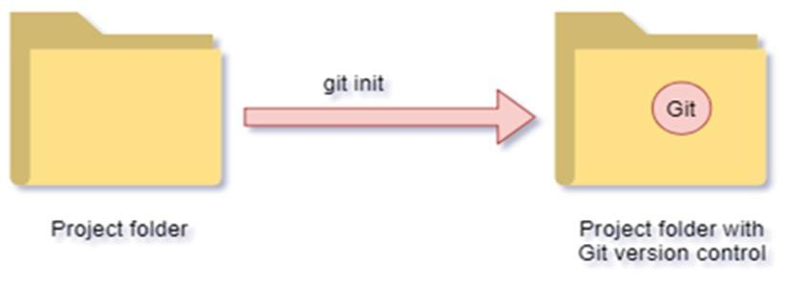
SETTING UP THE PROJECT FOLDER 1-3
Setting up a new project folder with Git
Adding Git to an existing project
folder
The .Git Directory

Slide 5
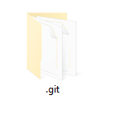
SETTING UP THE PROJECT FOLDER 2-3
Setting up a new project folder with Git
Adding Git to an
existing project
folder
The .Git Directory
Command:
git status => use to check either file is in git directory or not
git init => adds your folder to git repository

Slide 6
SETTING UP THE PROJECT FOLDER 3-3
Setting up a new project folder with Git
Adding Git to an
existing project
folder
The .Git Directory
A Sub-Folder
for Objects
A Sub-Folder
for Refs
A Head File

Slide 7
Git Commands
git config –global user.name “[name]”
git config:
        “This command sets the author name and email address respectively to be used with your commits. “
2. git init: “This command is used to start a new repository. “
3. git add --a: “This command adds a file to the staging area. “
4. git commit -m:
          “ This command records or snapshots the file permanently in the version history. “
5.(code .) : opens your current folder in vs code
git config –global user.email “[email address]”
git commit -m “[ Type message]”

Slide 8
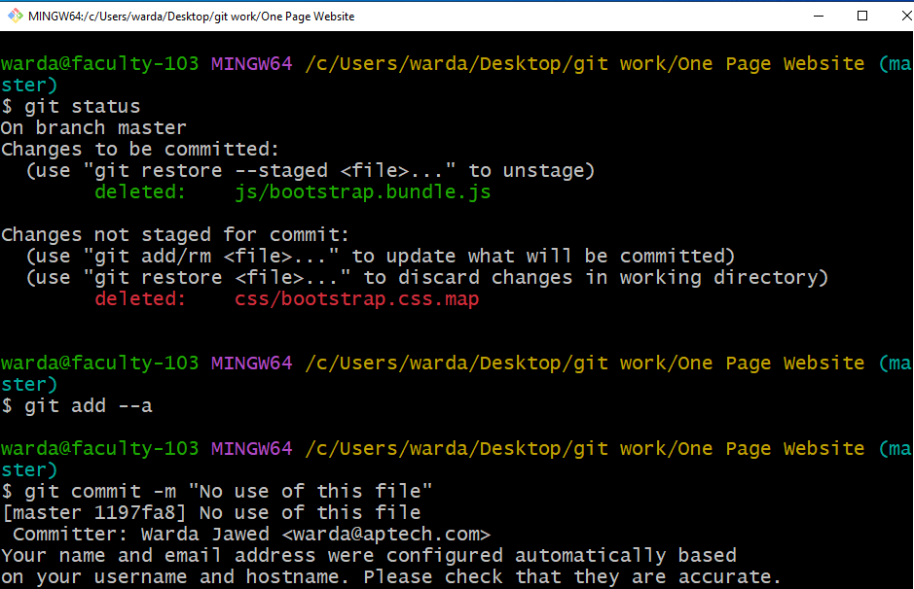
Git Commands for showing changes made
Make changes in file than again check status(git status)
And than commit your new changes(git commit –m “Changes made”)
git log: “This command shows you all commits made in your folder “

Slide 9
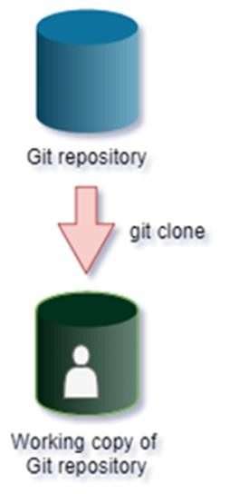
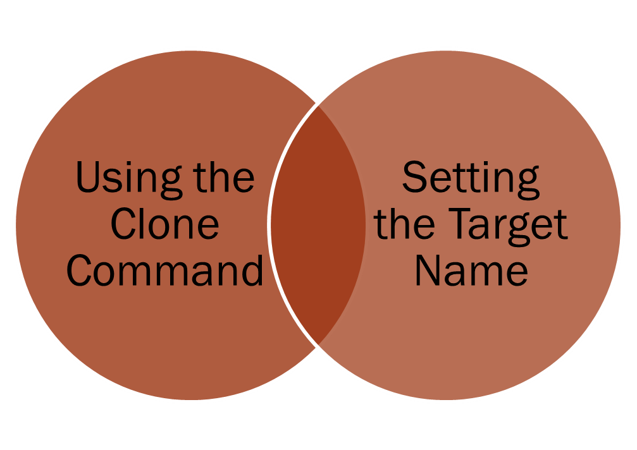
GIT CLONE

Slide 10
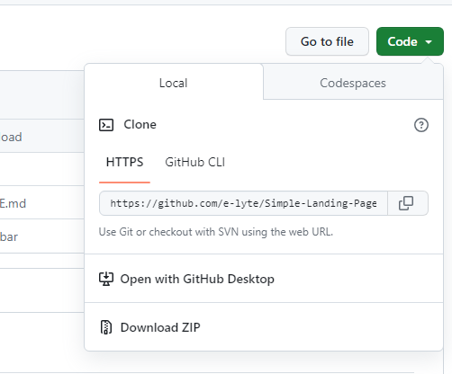
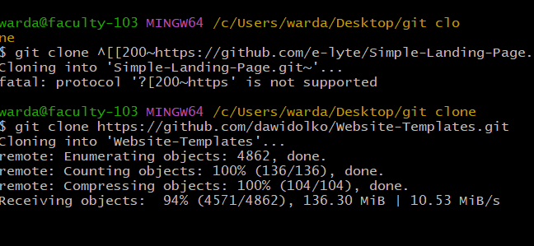
Command to clone other website to your local server
First you have to find demo website on GitHub
Copy the code
Then open git bash in your folder write git clone command and paste the link

Slide 11
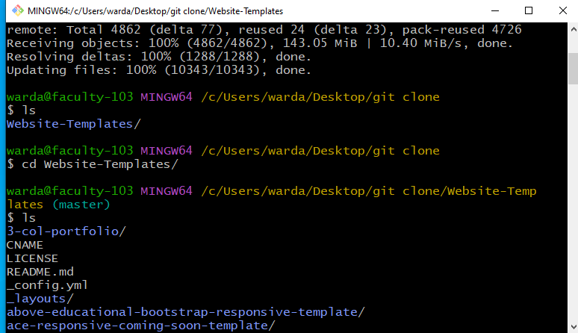
“ls” command to check list of folders in current directory
Write w and press TAB to autocomplete

Slide 12
“ls” command to check list of folders in current directory
Now you can run the previous command to add /del files check status and commit
like(pg:06)
Write w and press TAB to autocomplete

Slide 13
SUMMARY
Git provides commands to enable creating and cloning of a
Git repository.
It is easy to create and set up a Project folder with Git repository
You can add Git to an existing folder
Git configuration can be customized at various levels
Git clone command enables you to create a copy of a repository
The process of committing changes in Git is like saving
changes

